Slide 1
Value Toolkit Development
and Module Breakdown
Scoring guide
Defines Expectations
rubics
Different Levels

Slide 2
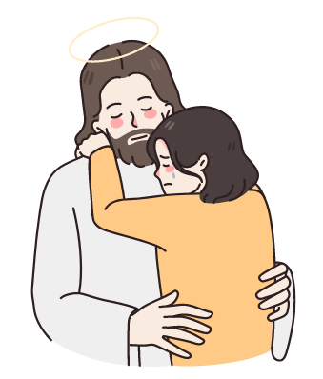
Value Toolkit Development
and Module Breakdown
makadiyos
Does the student demonstrate kindness and compassion towards others?
Shows respect for God or a higher power through actions and words?

Slide 3
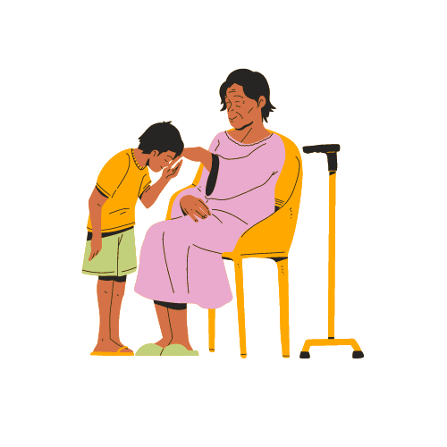
Value Toolkit Development
and Module Breakdown
Magalang
Treats others with courtesy and consideration.
How does the student show respect for teachers, peers and elders?

Slide 4
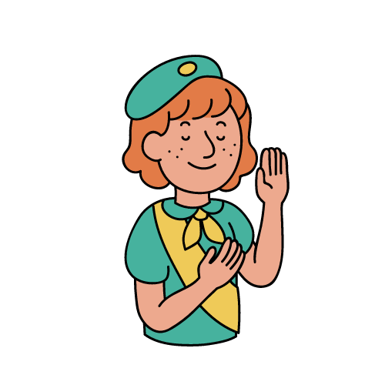
Value Toolkit Development
and Module Breakdown
Matapat
Tells the truth and acts with fairness.
Does the student take responsibility for their actions and complete work honestly?

Slide 5
Value Toolkit Development
and Module Breakdown
Masipag
Uses time and resources wisely and diligently.
How does the student manage their time effectively and put in consistent effort?

Slide 6
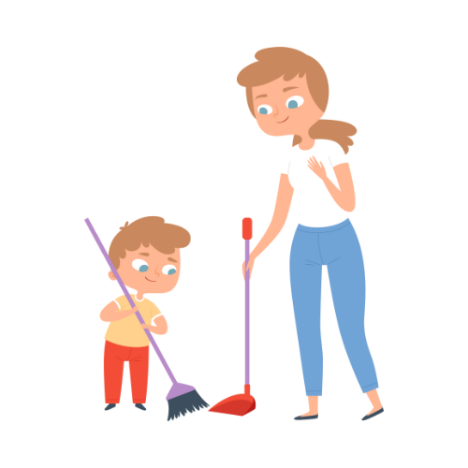
Value Toolkit Development
and Module Breakdown
Matulungin
Ready to offer assistance to others.
Is the student ready to offer help to others without expecting anything in return?

Slide 7
Value Toolkit Development
and Module Breakdown
Makabayan
Shows prides and care for the Philippines.
How does the student Demonstrate pride in their country and cultural heritage?

Slide 8
Value Toolkit Development
and Module Breakdown
Mapanuri
Acts responsibly and ethically online.
Does the student critically evaluate online information and use technology responsibly?

Slide 9
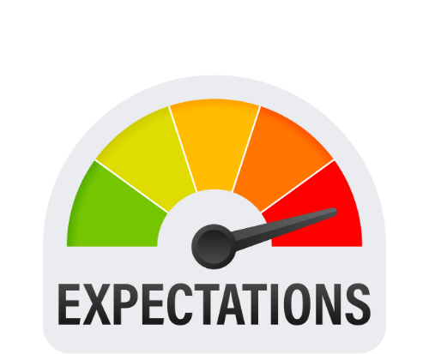
Value Toolkit Development
and Module Breakdown
Levels
Descriptors
RubRics

Slide 10
Value Toolkit Development
and Module Breakdown
EXAMPLE:
Basic Template
Level | Description | Example Behaviors
Exceeds Expectations | Consistently demonstrates the value | ...
Meets Expectations | Demonstrates the value most of the time | ...
Needs Improvement | Demonstrates the value inconsistently | ...
Does Not Meet Expectations | Rarely demonstrates the value | ...

Slide 11
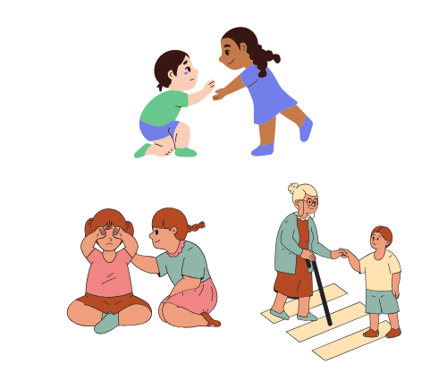
Value Toolkit Development
and Module Breakdown
EXAMPLE:
MAKADIYOS
THE STUDENT CONSISTENTLY Demonstrates kindness and compassion
They actively participate in acts of service and treats everyone with respect

Slide 12
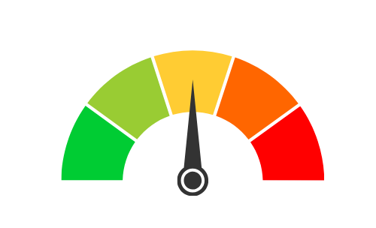
Value Toolkit Development
and Module Breakdown
EXAMPLE:
MAKADIYOS
THE STUDENT shows kindness and respect most of the time
They participate in some service activities

Slide 13
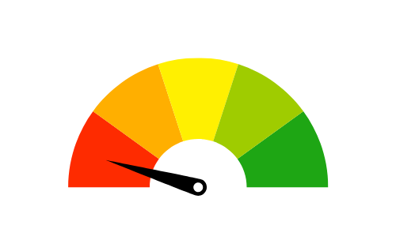
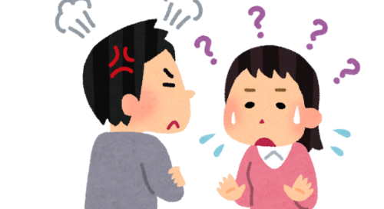
Value Toolkit Development
and Module Breakdown
EXAMPLE:
MAKADIYOS
THE STUDENT sometimes struggles to show kindness and respect
They rarely participate in service activities.

Slide 14
Value Toolkit Development
and Module Breakdown
Tailor to grade level and context
Add point value for quantitative assessment

Slide 15
Value Toolkit Development
and Module Breakdown
magalang
Uses respectful language
listens attentively
helps classmate

Slide 16
Value Toolkit Development
and Module Breakdown
matapat
Completes assignments honestly
Admits mistakes
Avoids cheating

Slide 17
Value Toolkit Development
and Module Breakdown
Masipag
Completes tasks on time
Uses materials responsibly

Slide 18
Value Toolkit Development
and Module Breakdown
matulungin
Offers help without being asked
shares materials
Encourages others

Slide 19
Value Toolkit Development
and Module Breakdown
Makabayan
Respects National symbols
Participates in cultural activities
Supports Filipino products
Votes for candidates with model Filipino characteristics

Slide 20
Value Toolkit Development
and Module Breakdown
mapanuri
Avoids Cyberbullying
Protects privacy online
Uses technology responsibly

Slide 21
Value Toolkit Development
and Module Breakdown

