Slide 1
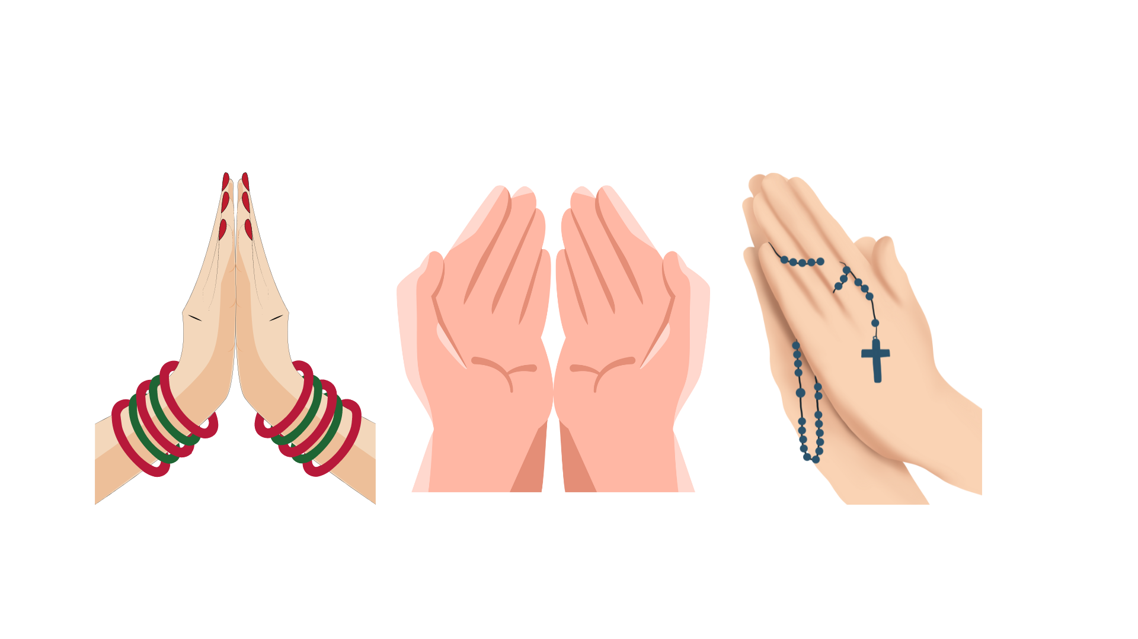
MODULE OVERVIEW
MODEL FILIPINO
MODEL FILIPINO
6 BOOKS
MAPANURI
MAGALANG
MATULUNGIN
MATAPAT
MASIPAG
MAKA-DIYOS
God Fearing
God Loving
MAKABAYAN
11 PODCASTS
MODEL NETIZEN

