Slide 1






Teaching 101
For non-teachers
Tips to keep your learners engaged and excited to learn

Slide 2

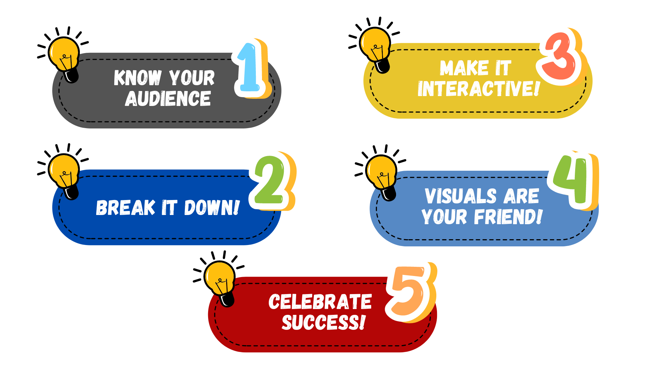

Teaching 101
For non-teachers

Slide 3

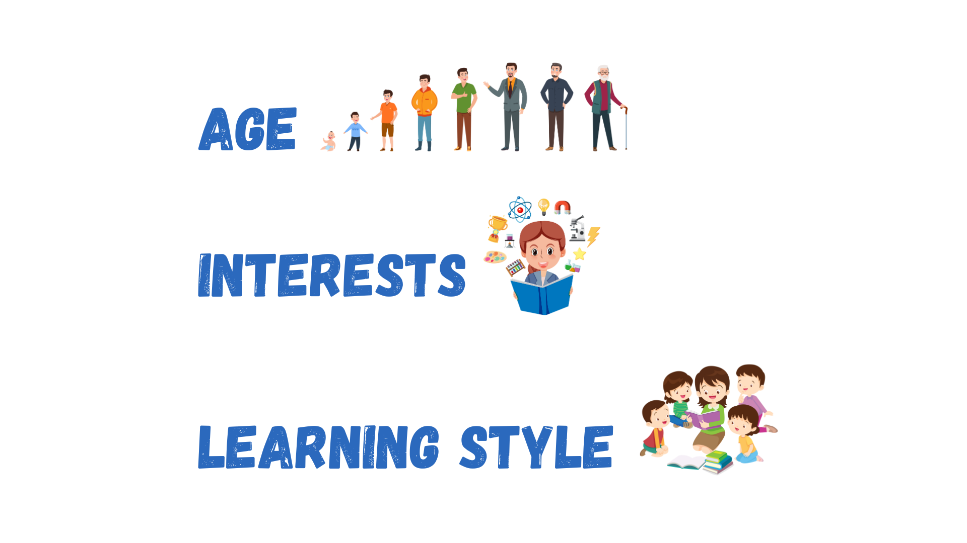


Teaching 101
For non-teachers
It’s important to tailor your approach to your audience

Slide 4

Teaching 101
For non-teachers

Slide 5





Teaching 101
For non-teachers
Step 1
Step 2
Don’t overwhelm your learners with too much information at once
step 3

Slide 6

Teaching 101
For non-teachers

Slide 7





Teaching 101
For non-teachers
Learning shouldn’t be a one-way street
Interactive and fun

Slide 8

Teaching 101
For non-teachers

Slide 9




Teaching 101
For non-teachers
People learn visually
Real life objects
Keep your learners engaged

Slide 10

Teaching 101
For non-teachers

Slide 11



Teaching 101
For non-teachers
Positive reinforcement goes a long way
This will motivate them to keep learning and striving for improvement

Slide 12


Teaching 101
For non-teachers

Slide 13


Teaching 101
For non-teachers

Slide 14
Teaching 101
For non-teachers

